Slide 1
Aggregate Demand and Aggregate Supply
3.2
Copyright Bananaomics

Slide 2
Aggregate Demand
Copyright Bananaomics

Slide 3
Definition
Aggregate Demand
The total demand for goods and services produced in an economy. (The same quantity as GDP)
AD = C+I+G+(X-M)
Copyright Bananaomics

Slide 4
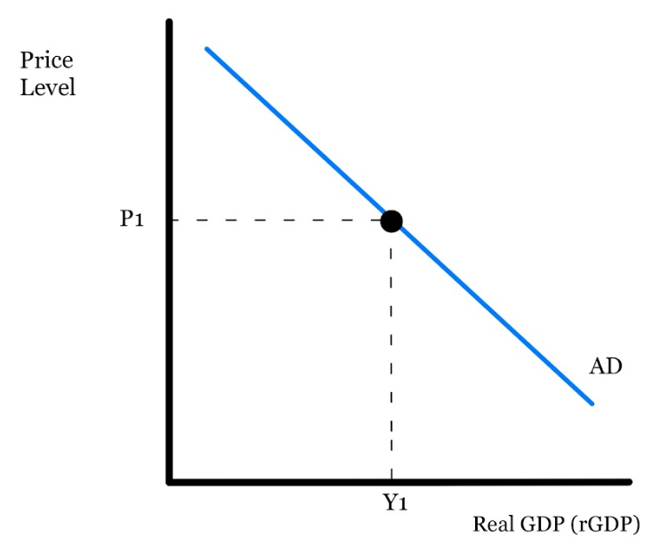
Graph
Copyright Bananaomics

Slide 5
Similarities Between AD and Demand
Both Downward sloping
Both have non-price determinants that shift the curve
Price or Price Level changes simply move along the curve rather than shift the curve.
Copyright Bananaomics

Slide 6
AD Non-Price Determinants
Consumption
Consumer Confidence
Unemployment
Taxes
Interest Rates
Wealth
Indebtedness
Future Expectations
Copyright Bananaomics

Slide 7
AD Non-Price Determinants
Investment
Interest Rates
Business Confidence
Technology
Business Taxes
Corporate Indebtedness
Copyright Bananaomics

Slide 8
AD Non-Price Determinants
Government
Government Spending
Copyright Bananaomics

Slide 9
AD Non-Price Determinants
Net Exports
Income of Trading Partners
Exchange Rates
Change in Trade Policies
Health and Safety Requirements
Copyright Bananaomics

Slide 10
Practice
Determine whether the following scenarios will have an impact on Chinese AD and if so, what.
Tax cuts, consumers decide to buy a new car
Worried about a budget deficit, the government decides to buy fewer military planes
Increasing prices result in consumers buying more foreign goods
Businesses are optimistic about the future
Interest rates have increased leading to a lack of spending on new machinery
To fight unemployment, the government hires more in national parks
A foreign government imposes a tariff that discourages its citizens from purchasing Chinese goods.
A large depression hits China, incomes fall drastically
Chinese prefer to buy German cars rather than Chinese cars
Income taxes decrease drastically for individuals.
Copyright Bananaomics

Slide 11
Activity
Find a real-world article that you believe would shift the Aggregate Demand Curve.
Draw the AD Curve
Draw the change/shift in the curve
Explain the impact from this change on real GDP, inflation, and unemployment.
Copyright Bananaomics

Slide 12
Short-Run Aggregate Supply
Copyright Bananaomics

Slide 13
Definition
Aggregate Supply
Separated into two categories :
Short-Run Aggregate Supply: The total quantity of real output (real GDP)offered at different possible price levels in the short run.
Long-Run Aggregate Supply: Aggregate supply that is dependent upon the resources and technology in the economy, thus being independent of the price level. It is vertical at the level of potential output. It can only be increased by improvements in the quantity and/or quality of factors of production as well as improved technology.
Copyright Bananaomics

Slide 14
Definition
Natural Rate of Unemployment (Full Employment)
The rate of unemployment that occurs when the economy is producing at its potential output or full employment level of output.
Copyright Bananaomics

Slide 15
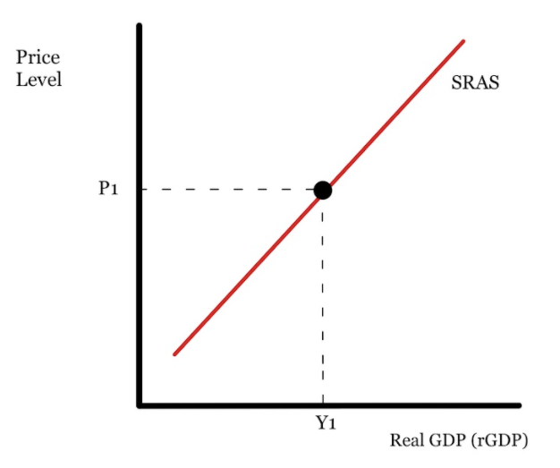
Graph
Copyright Bananaomics

Slide 16
SRAS Non-Price Determinants
Cost and Availability of Resources
Copyright Bananaomics

Slide 17
SRAS Non-Price Determinants
Government Intervention
Subsidy
Taxes
Regulation
Copyright Bananaomics

Slide 18
SRAS Non-Price Determinants
Supply Shocks
An event that drastically alters supply. Such as a natural disaster.
Copyright Bananaomics

Slide 19
Alternative SRAS Views
Neo-Classical vs Keynesian
Copyright Bananaomics

Slide 20
Copyright Bananaomics

Slide 21
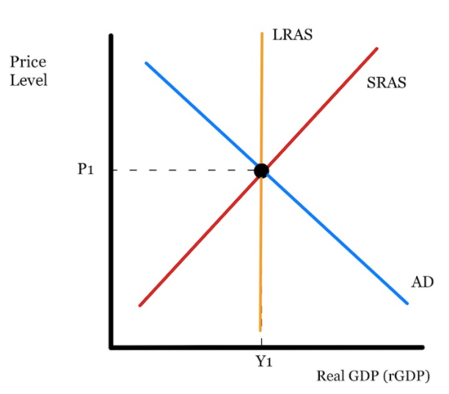
New ("Neo") Classical
Founded in 1970s
General Equilibrium Approach
Assumes prices are flexible in the long-run. Didn't do well at prediction as prices and wages tended to be "sticky"
Enforces the idea that the market will fix itself and return to equilibrium (Full Employment).
Copyright Bananaomics

Slide 22
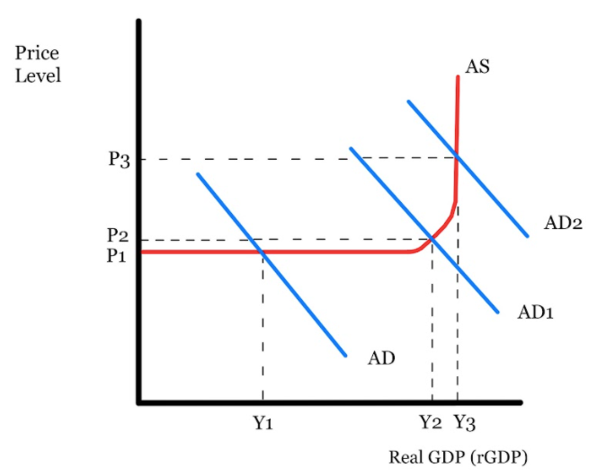
Keynesian Model
Founded by John Maynard Keynes
Founded this model when Neo-Classical Models were not fixing The Great Depression.
States that wages are "sticky" meaning they are slow to change due to labor laws, contracts, salaries, etc.
Argues the economy gets stuck in a short-run position. (Only one Aggregate Supply Curve)
Graph (3 Sections)
Copyright Bananaomics

Slide 23
Keynesian Model
Graph (3 Sections)
Capacity: Maximum Level of output possible
Horizontal Section - A fair amount of spare capacity. Room to increase rGDP.
Upward Sloping Section - Still some spare capacity yet competition for scarce resources begin.
Vertical Section - Little/no spare capacity. Full Employment reached.
Copyright Bananaomics

Slide 24
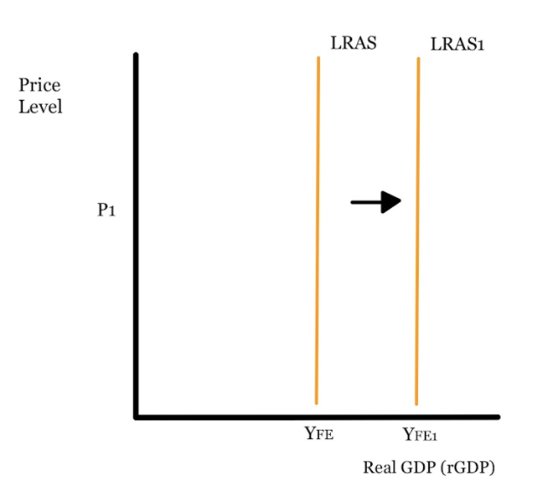
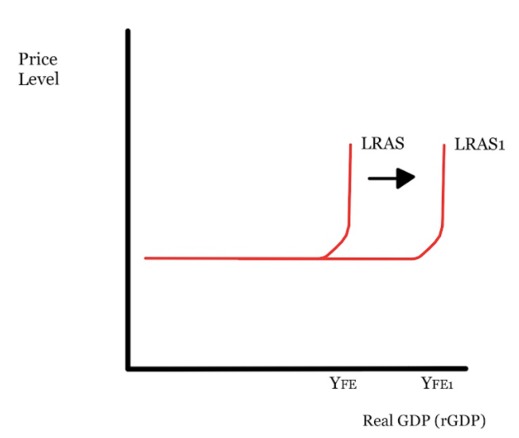
Long Run Aggregate Supply (LRAS)
Shifters
Similar to PPC Shifters
Change in Quality or Quantities of Factors of Production
Technological Improvements
Increase in Efficiency
Changes in Institutions
Copyright Bananaomics

Slide 25
Macroeconomic Equilibrium
Copyright Bananaomics

Slide 26
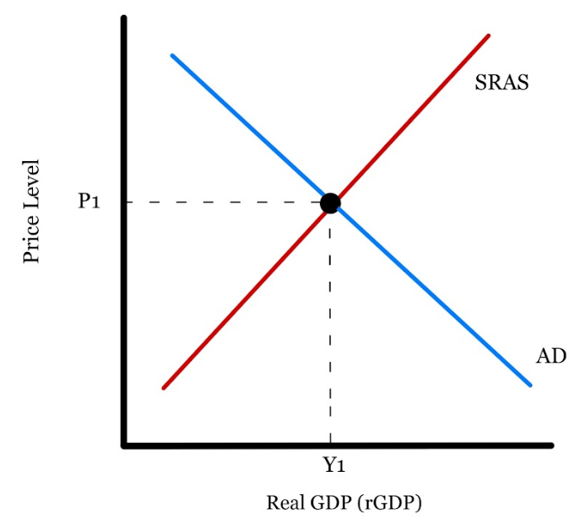
Short Run Equilibrium
Copyright Bananaomics

Slide 27
Review AD Shifters Discussion
Discuss with a partner the non-price determinants (Shifters) of Aggregate Demand.
Copyright Bananaomics

Slide 28
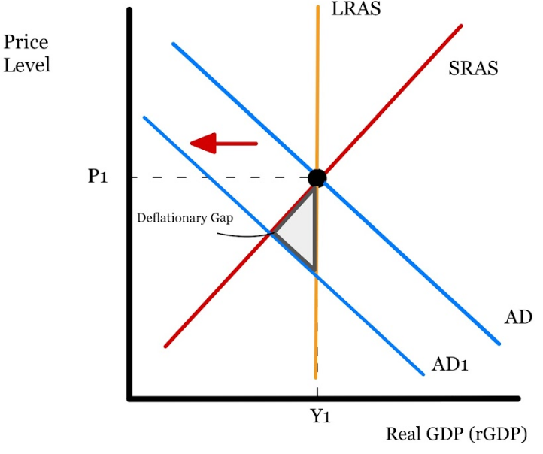
AD Shifts
Recessionary/Deflationary Gap
When the equilibrium level of real outputis less than potential output as a result of adecrease in AD.
Copyright Bananaomics

Slide 29
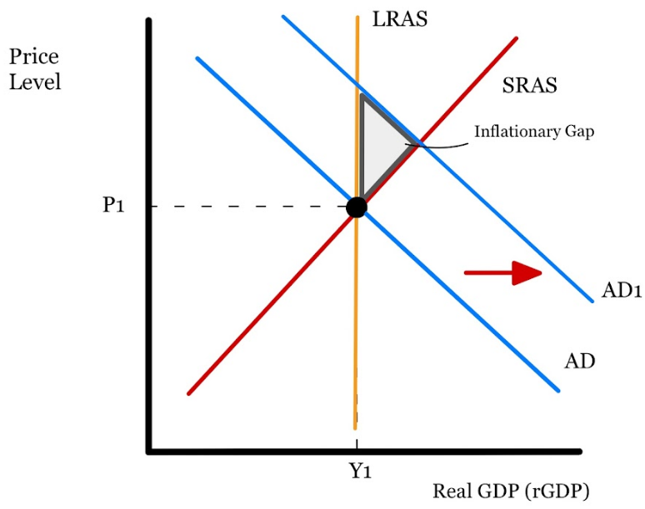
AD Shifts
Inflationary Gap
The case where equilibrium real output exceeds potential output as a result of an increase in AD.
Copyright Bananaomics

Slide 30
Review SRAS Shifters Discussion
Discuss with a partner the non-price determinants (Shifters) of Short-Run Aggregate Supply.
Copyright Bananaomics

Slide 31
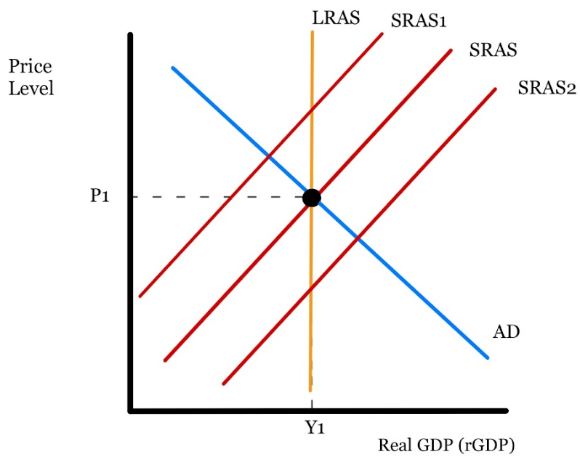
SRAS Shifts
Stagflation and Growth
Stagflation: Decrease in RealGDP and an Increase Unemployment Rate and Price Level (Inflation).
Stagflation is extremely undesirable for an economy. (SRAS1)
Typical growth may also occur in the short run. (SRAS2)
Copyright Bananaomics

Slide 32
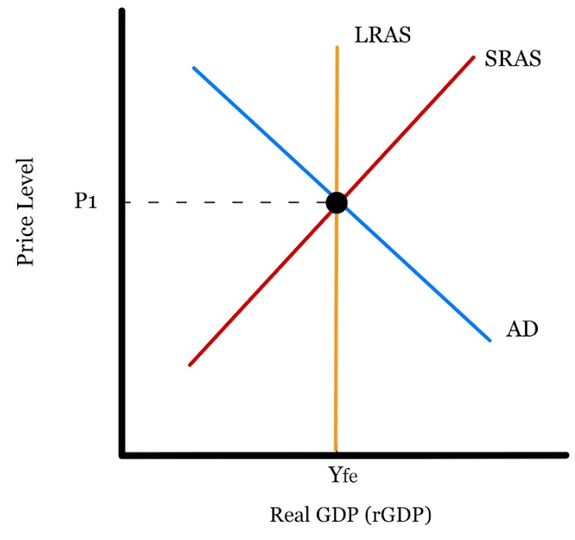
Long Run Equilibrium
In the short run, inflationary and recessionary gaps exist. However, in the long run, the equilibrium point must return to the LRAS (Full Employment).
Copyright Bananaomics

Slide 33
Connections!
Discuss the connections between deflationary and inflationary gaps with the business cycle
Copyright Bananaomics

Slide 34
Long Run Equilibrium Adjustments
Falling Aggregate Demand.
Practice drawing aggregate demand falling and attempt to analyze how the graph adjusts to the long run.
Copyright Bananaomics

Slide 35
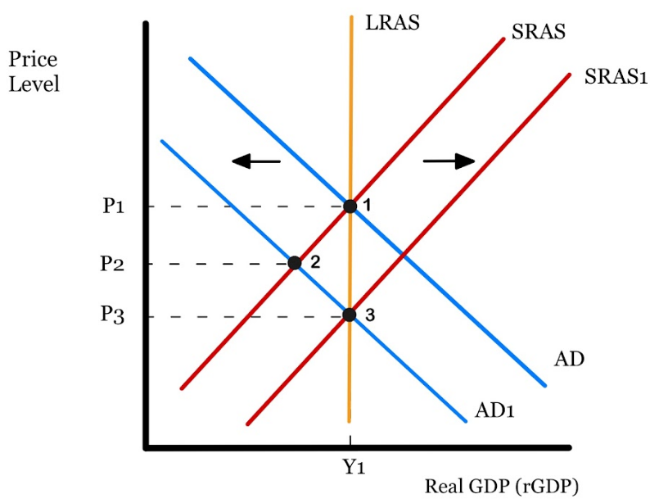
Long Run Equilibrium Adjustments
Falling Aggregate Demand.
A decrease in AD results in a decrease in Price Level (P1-P2) across the economy. This results in the cost of inputs (wages) lowering, allowing companies to hire more workers, and therefore, increasing SRAS.
Copyright Bananaomics

Slide 36
Long Run Equilibrium Adjustments
Rising Aggregate Demand.
Practice drawing aggregate demand rising and attempt to analyze how the graph adjusts to the long run.
Copyright Bananaomics

Slide 37
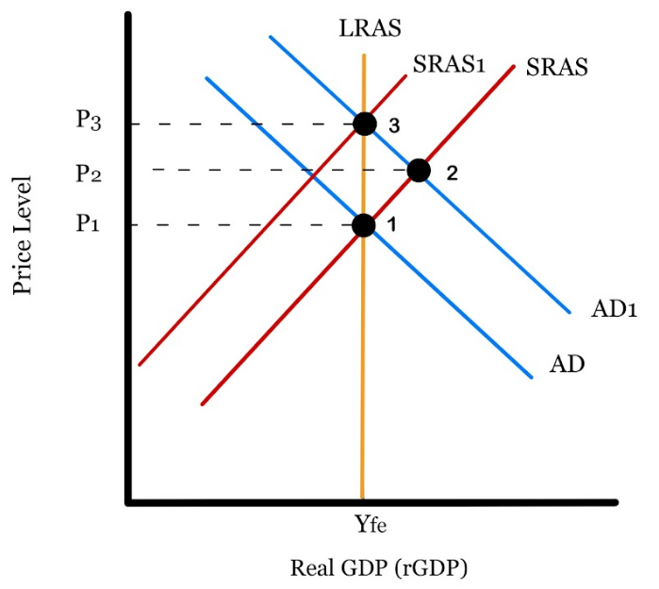
Long Run Equilibrium Adjustments
Rising Aggregate Demand.
An increase in AD results in an increase in Price Level. This results in the cost of inputs (Wages) increasing and therefore, SRAS decreasing.
Copyright Bananaomics

Slide 38
Keynes vs Classical
Copyright Bananaomics

Slide 39
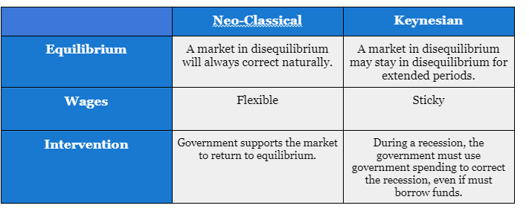
Assumptions
Copyright Bananaomics

Slide 40
Neo-Classical Practice
For long run - skip to 10 minute mark
Copyright Bananaomics

Slide 41
Closing Activity
Use this random country generator to select a country.
Find 3 news articles that outline a reason for AD, SRAS, and LRAS to shift. Draw the shift and write a 2-3 sentence summary of the effects for each shift. Be sure to discuss things like Price Level, real GDP, Inflation, Unemployment, and the cause of the shift.
For AD and SRAS, draw the shift in the short run and a separate showing the long run adjustment.
Copyright Bananaomics

Slide 42
Enjoying The Content?
Visit bananaomics.com to purchase package deals with discount prices!
BANANAOMICS

